Slide 1
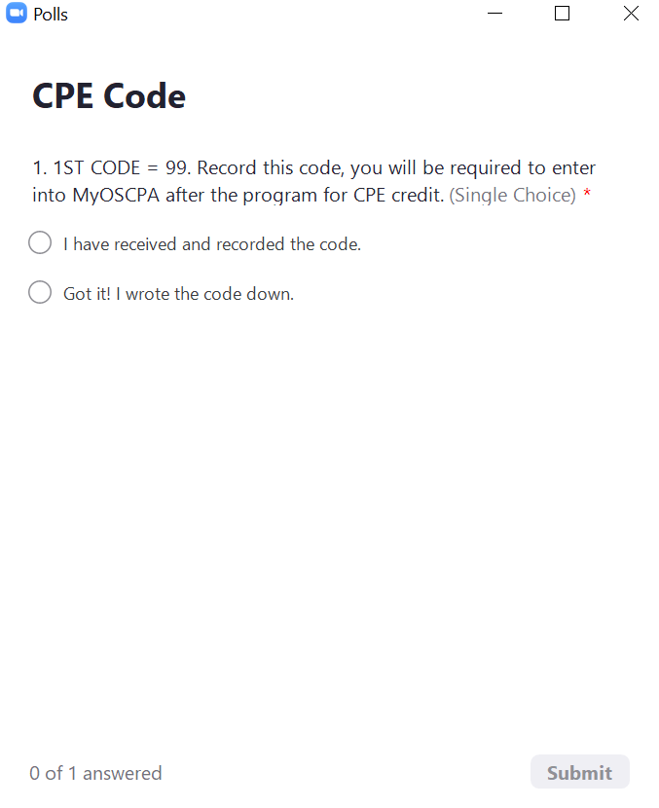
CPE CODE CHANGES
After this webcast, please return to my.ohiocpa.com to enter the codes. Select the "Enter Codes" button on the agenda page and enter all three 2-digit codes that we will present via Polls throughout the presentation. Each code Poll will appear on the screen for 5 minutes.
SAMPLE ONLY: DO NOT RECORD THIS CODE.

Slide 2
ohiocpa.com/octobershow
ohiocpa.com/novembershow

Slide 3
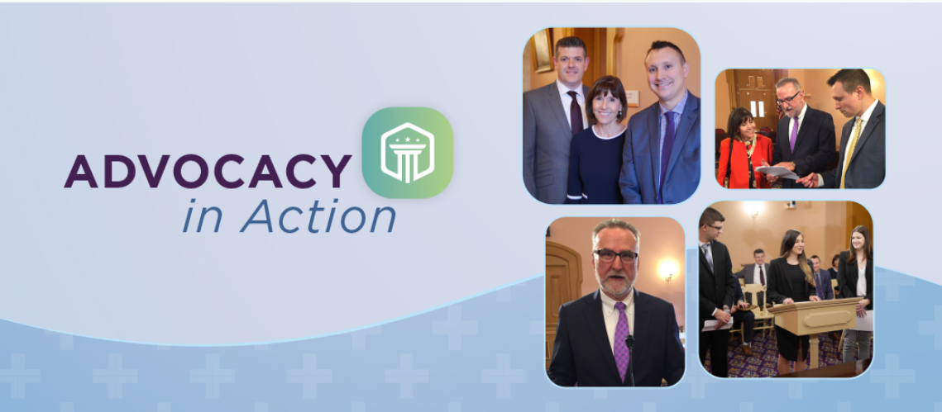
Explore the value of your voice & vote
Sept. 30, 2022 | 9:00 a.m. to Noon
Join us for Advocacy in Action
For more information and to register, visit:
www.ohiocpa.com/AIA

Slide 4
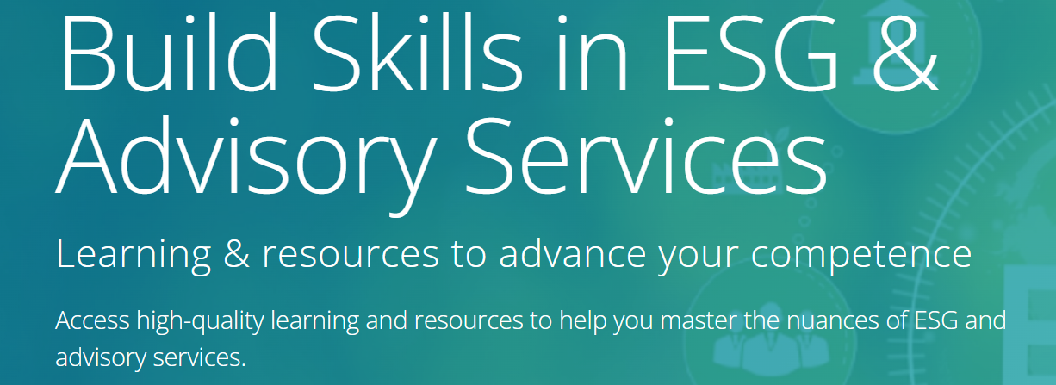
The Impact of ESG Matters on Financial Reporting & Audits
Aug. 31 | 4 p.m. to 6 p.m.
The Rising Tide of ESG: Trends & Integration
Complimentary On-Demand
Advisory Services Virtual Conference
Sept. 21, 2022 |
https://my.ohiocpa.com

Slide 5
OSCPA TOWN HALL
​ Transforming the State of Business...Together​

Slide 6
Thank you to our sponsor
Visit ohiocpa.com/myperks to view exclusive member savings on Dell products.

Slide 7
OSCPA TOWN HALL
​ Transforming the State of Business...Together​
Notes:
Welcome to the OSCPA Town Hall! Today, we’re going to discuss the topic of cybersecurity: from emerging threats that need to be on your radar to measures you need to put in place to protect your organization. We’ll also discuss this topic through the broader lens of enterprise risk management and what that means for your business. Finally, we’ll update you on legislative and regulatory developments we’re monitoring on your behalf. We have a full agenda, so let’s get started!

Slide 8
JAKE NIX, CPA, CISM, CISA
founder & ceo
riscpoint
Notes:
I’m pleased to welcome Jake Nix as our guest for today’s Town Hall. Jake is Founder & CEO of RISCPoint, a business-focused risk, technology and cybersecurity consulting group. Jake is also an Ohio CPA/PAC board member and member of OSCPA. Prior to founding RISCPoint, Jake served in a global risk and controls transformation role working with firm leadership and executives to shape firm methodology and design innovative compliance programs for Fortune 500 clients. Jake, welcome to today’s Town Hall!
** QUESTIONS FOR JAKE **
Why should cybersecurity be a priority for organizations?
What are some of the most common risks and hacks associated with inadequate cybersecurity controls? What are the worst ones you’ve seen?
With the risks we've discussed I understand there are programs our members might want to know about. Where would you start with a cyber program and what can be the strategic advantage of implementing a program?
Why is risk management so important and how is the best way to approach it? (EX: vendor risk management often being overlooked, Shadow IT, finding IT experts)
We hear from some organizations that they are too small to deal with all of this because of time challenges, cost challenges, etc. What would you say to them? (EX: it’s a myth, all the options are way out of my budget)
Is there anything else we didn’t touch on that our members need to know?
You’ve unpacked a lot in a short time this morning. What are the top 2-3 points Ohio CPAs should take away from today’s discussion?

Slide 9
QUICK POLL
Which of the following cyber risk area concerns you the most?
Ransomware event
Inability to receive adequate cybersecurity/breach insurance
The expense of cybersecurity/breach insurance
Not fully understanding what a, b, and c mean for my business
Notes:
And now, for our first Quick Poll, we’d like to get your take on which cyber risk area concerns you the most.

Slide 10
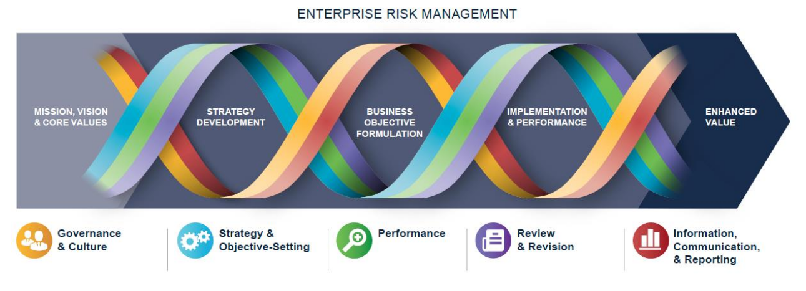
ENTERPRISE RISK MANAGEMENT
SOURCE: https://www.coso.org/Shared%20Documents/COSO-ERM-Presentation-September-2017.pdf
Notes:
As Jake just discussed, Enterprise Risk Management, or ERM, is important to all organizations, regardless of size—particularly in light of the current environment. And cybersecurity is just one aspect to be examined through an ERM process. This graphic illustrates the five components of the COSO ERM framework and shows how the interplay between components is crucial to generating enhanced value:
Governance and Culture: As any good strategy does, it starts with your mission, vision & core values—the drivers of your organization. Spending time here ensures you’re setting your organization up for success as it requires you to define the culture you seek to create, the operating structure and board oversight, and your commitment to your core values, which ultimately impacts your ability to attract, retain and develop top talent.
Strategy & Objective-Setting: This is where you analyze business context and define your risk appetite. Based on that appetite, you evaluate alternative strategies and develop your business objectives.
Performance: At this stage, you dial in on the risks associated with your strategy. You identify and prioritize your organization’s risks and assess their severity. Then you implement risk responses through a portfolio view of the business.
Review & Revision: As with any good strategy, you monitor, assess and refine with an eye to continuous improvement of the process.
Information, Communication & Reporting: Leveraging information and technology, this is the stage where you communicate risk information, including reporting on risk, culture and performance.

Slide 11
ENTERPRISE RISK MANAGEMENT
SOURCE: https://www.coso.org/Shared%20Documents/COSO-ERM-Presentation-September-2017.pdf
Notes:
Some organizations do not see the value of ERM and view it as a distraction. But when done well and consistently, engaging in ERM allows your organization to:
Integrate it with business practices, which results in better information that supports improved decision making and leads to enhanced performance
Enhance your organization’s focus on value and how you create, preserve and realize value.
Link to strategy from three different perspectives:
The alignment of mission, vision and core values with business strategy and objectives
The implications of the strategy chosen
The risks involved in executing the strategy
OSCPA engaged in its first ERM exercise in 2016, relying on this framework when it was in draft format. We now have an OSCPA board task force in place that reviews our risk framework annually.

Slide 12
QUICK POLL
Where is your organization in implementing ERM?
We have engaged in ERM for years
We are just in the beginning stages of implementing an ERM framework for our organization
We are too small and don’t have the time or resources to devote to ERM
We don’t see the value in engaging in ERM
Notes:
It's time for our next Quick Poll question. Tell us where you are on implementing ERM in your organization.

Slide 13
GOVERNMENT RELATIONS
Issue advocacy update
Notes:
Now, let’s turn our attention to several key legislative developments.

Slide 14
OSCPA 2022 Priorities
BID and Business Sales (House Bill 515)
Clarifies that residents' gains from the sale of an ownership interest in a business is considered business income for Ohio income tax purposes (BID).
Signed on June 24; effective date is Sept. 23, 2022
SALT Deduction Cap Parity (Senate Bill 246)
Authorizes a PTE owner to claim a refundable credit against the owner’s Ohio income tax liability equal to the owner’s proportionate share of the tax paid by the PTE.
Map of states with pending or enacted legislation
Signed on June 14; effective date is Sept. 13, 2022
Notes:
Two of the Society’s top legislative priorities were recently signed into law by Gov. DeWine in June.
BID and Business Sales. OSCPA achieved a legislative change in response to the Tax Department's audits of resident business sales, which arose from a 2016 Ohio Supreme Court decision that only benefitted non-residents. This law change will clarify that gains resulting from the sale of an ownership interest in a business are considered business income for Ohio income tax purposes (BID), provided the sale satisfies either of the following: 1) the sale is treated for federal income tax purposes as the sale of assets; or 2) the seller was involved in the day-to-day management of the business during the taxable year in which the sale occurred or during any of the five preceding years. Without this change, business owners would have continued to leave Ohio to become non-residents before the sale. The goal of this new law was to secure a remedial measure clarifying existing law so it can be applied to current audits. Our second priority bill deals with
SALT Deduction Cap Parity. Pursuant to a 2020 IRS change, states are permitted to enact legislation to clarify that taxes paid by a pass-through entity don't count towards an owner’s $10,000 SALT deduction cap for federal income tax purposes. As a result, OSCPA secured this Ohio law change authorizing a PTE owner to claim a refundable credit against the owner’s Ohio income tax liability equal to the owner’s proportionate share of the tax paid by the PTE. With Missouri also recently passing their SALT legislation, Ohio and Missouri became the 28th and 29th states to address this issue.
Senate Bill 246 (SALT cap parity) was signed on June 14; it takes effect Sept. 13, 2022. House Bill 515 (BID and business sales) was signed on June 24; the effective date is Sept. 23, 2022. Both bills passed the Senate and House on nearly unanimous votes.

Slide 15
Municipal Income Tax issues
Download our withholding FAQ guide: TY22 location where the employee is physically working, just as pre-pandemic law
Schaad v. Alder: Ohio Supreme Court took up the Cincinnati-based case for 2020 refunds
OSCPA will file an amicus brief on August 15
House Bill 519: seeks to both (1) limit notices sent to taxpayers on extension and (2) limit late fees for failure-to-file
Notes:
Looking closer to home on Ohio's municipal employer withholding issue, remember to download our extensive FAQ guide to get the answers you need to address local income tax challenges involved with a hybrid work environment. As of January 2022 the normal withholding rules apply at the location where the employee is physically working, just as the law was pre-pandemic.
Municipal Income Withholding and Refunds: Several cases were filed in Ohio questioning the constitutionality of requiring individual taxpayers to pay income tax to municipalities where they neither live nor physically worked. OSCPA worked hard to secure a solution on this issue which resulted in the legislature allowing 2021 refunds. Two cases have reached the Ohio Supreme Court dealing with the 2020 refunds. Both were decided against the taxpayers at the appellate level, and the Ohio Supreme Court declined to hear the first appeal (Columbus) in March 2022. However, the Ohio Supreme Court voted 4-3 on June 7, 2022 to take up the second case (Cincinnati), Schaad v. Alder. OSCPA agrees with the taxpayer's constitutionality concerns and will file an amicus brief mid-August. The Court has yet to set a hearing schedule, but the case likely will not have oral arguments until late 2022 or early 2023, leaving 2020 muni tax refunds up in the air until a decision is released.
House Bill 519: Another pending OSCPA legislative priority seeks to make two changes to the administration and enforcement of municipal income taxes: (1) limits the circumstances under which municipal income tax inquiries or notices may be sent to a taxpayer who has received a filing extension; and (2) limits the late fees that may be imposed on a taxpayer for failing to timely file municipal income tax returns. H.B. 519 passed the House 61-29 on March 30, 2022 and is awaiting hearings in the Senate Ways & Means Committee. The Society will testify in support as we did in the House.

Slide 16
QUICK POLL
Ohio's existing municipal income tax system is:
Fine as is
A huge administrative compliance burden for those filing in multiple locations and needs overhauled
Administration should be centralized to one entity
Eliminate it and create alternative revenue source for cities
Notes:
And our last Quick Poll question aims to take a pulse check on what you think about Ohio's muni tax system?

Slide 17
ohiocpa.com/octobershow
ohiocpa.com/novembershow
Notes:
We encourage you to register for one of this year's Ohio Accounting Shows. It's your chance to hear from global, national and local thought leaders, including futurist Lisa Bodell leading a general session titled Killing Complexity: Why Simplicity Wins. I will also be providing an update on the profession during a general session. In addition to getting core technical updates, you can fulfill your ethics requirement and hone your skills in nine core competencies across 10 tracks. Visit MyOSCPA to register.

Slide 18
Explore the value of your voice & vote
Sept. 30, 2022 | 9:00 a.m. to Noon
Join us for Advocacy in Action
For more information and to register, visit:
www.ohiocpa.com/AIA
Notes:
It's an election year, so your voice and vote matter more than ever. Be sure to join us September 30 to see why at Advocacy in Action. This program gives you an inside look at the inner workings of the Ohio Supreme Court, the value lawmakers place on your involvement, and the thought process involved in OSCPA's legislative agenda. Visit ohiocpa.com/AIA to learn more and register.

Slide 19
The Impact of ESG Matters on Financial Reporting & Audits
Aug. 31
4 p.m. to 6 p.m.
The Rising Tide of ESG: Trends & Integration
Complimentary On-Demand
Advisory Services Virtual Conference
Sept. 21
10:30 a.m. to 3:30 p.m.
https://my.ohiocpa.com
Notes:
And finally, I'd like to call your attention to the variety of learning events we've assembled to help you get a handle on ESG and advisory services. For details or to register, visit my.ohiocpa.com and search for ESG and advisory.10:

Slide 20
Thank You!
Register now to join us for the remaining Town Hall programs
Sept. 15 | Oct. 20 | Dec. 15
www.ohiocpa.com/mylearning
Notes:
And that’s all we have time for today. Thank you for tuning in. We hope to see you at our three remaining Town Halls.

